Slide 1


Research Initiation Seminar
Glasses detection with CNN/Deep Learning
Safran Morpho
Maha Elbayad, Simon Rodriguez
Supervisor
C. Herold
ECP Supervisor
N. Paragios

Slide 2
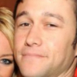
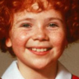
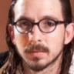
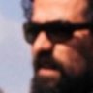
Subject
Train a CNN to say whether a facial image contains eyeglasses or not.
Training dataset : labelled using an older, gradient-based detector ➞ noisy labels.
How to deal with noisy labels ?
How to get the best performances ?
How to binarize the old classifier scores ?
5.05
18.37
64.21
17.00
Old classifier scores
Notes:
Simon
Passer d'abord du temps sur le graphe
Pas de lunettes : easy, autres : graidents

Slide 3
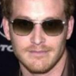
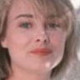

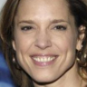
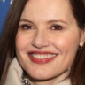
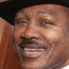
Setting
We use the Caffe framework, with a fixed predefined network architecture:
3 x {conv-ReLU-pool} + 2 x fully connected layers
Dropout (50%)
Softmax with loss (multinomial logistic loss)
Database : CASIA WebFace
380k faces (collected from IMDB)
96 x 96 x RGB
Cropped, scaled and centered on the eyes.
Variable poses, lighting, expressions, ethnies and image quality.
Notes:
Simon

Slide 4
Tackling the problem
Two approaches:
Preprocess the dataset. Always needs to be adressed, as the scores given by the old classifier are in [0,255], and we want to convert it to a binary classification problem.
Handle the noisy labels during the training phase.
Change the structure of the CNN, by adding new layers to correct the errors or learn the noise or using custom losses.
Use a small hand-annotated subset for regularization.
Classical perf. improvements methods of machine learning.
Notes:
Maha

Slide 5
State of the art
Preprocessing
Thresholding the scores, studying the repartition of labels. * (Frenay & Verleysen, 2014)
Reject uncertain samples. *
Learn the error of the old classifier to correct the labels. *
During training
Different losses on different subsets. (Zhou & Liu, 2006)
Design or learn a confusion matrix. * (Sukhbaatar et al., 2014)
Classes for different types of noise. (Natarajan et al., 2013; Xiao et al., 2015)
Learn the error of the old classifier to correct the labels. *
Bootstrapping, bagging. *
Various prerequisites on the knowledge of the noise distribution, on a small hand-labeled subset of the training set, etc.
Notes:
Maha
Préciser celles faites mais pas présentée

Slide 6
Establishing a baseline
Datasets:
Name | #samples | Labels | % positives
Test | 4.6K | hand-labelled | 5
CASIA | 375K | noisy | 5
Tr1 | 5K | hand-labelled | 5
Tr2 | 5K | hand-labelled | 20 (other source)
Tr3 | 10K | hand-labelled | 20 (Tr1+Tr2, adjusted)
Baseline:
Compare the old gradient-based detector with a CNN trained on Tr1 (no noise).
Tr1:
Accuracy: 0.985
AUC: 0.966
Avg. Precision: 0.913
Old:
Accuracy: 0.962
AUC: 0.920
Avg. Precision: 0.679
Notes:
Simon
Expliciter les graphes

Slide 7
Influence of the set size
Importance of the set size : how do training on a small hand-labelled subset and training on a big noisy set compare?
 | Dataset | Labels | % of positives
Clean | Tr1 | Hand-labelled | 5%
Noisy | CASIA | Automatically generated using the old scores | Sampled and thresholded at 26.7 to get 5% of positives.
Annex
Notes:
Simon

Slide 8
Impact of the labels ratio
What about the repartition of the labels ? Clearly unbalanced.
➞ Clean : nested databases starting from TR3 (resp. TR1).
➞ Noisy: nested databases starting from CASIA(5%) (resp. a balanced CASIA(20%)).
Annex
Improvement when trained on a clean set, not when trained on a noisy one.
Notes:
Maha
Expliciter old classifier

Slide 9
Handling the class imbalance
Consider a loss per class to weight out the asymmetry of the classes:
Intuition:
Differentiate the costs associated with false positives and false negatives.
Refinements with adjusted loss (blue) gives better results
Tr3 softmax:
(Ap:0.957, AUC:0.993)
Tr3 unbalanced :
(Ap: 0.975, AUC:0.997)
Annex
Notes:
Maha

Slide 10
Preprocessing
Thresholding: intuitive way to binarize while respecting the labels repartition.
By setting a threshold slightly above the observed repartition,
we re-balance the training set
in a non-uniform way.
0
Th
255
Label 0
Label 1
Margin: tested a rejection margin around the threshold (fixed at 5%).
Best performance for a margin of 15 points:
286K images, 9.5K positive labels, Acc: 0.968, AUC: 0.962
Annex
Notes:
Simon

Slide 11
Preprocessing
Thresholding: intuitive way to binarize while respecting the labels repartition.
By setting a threshold slightly above the observed repartition,
we re-balance the training set
in a non-uniform way.
Mg
0
Th
255
Label 0
Discarded
Label 1
Margin: tested a rejection margin around the threshold (fixed at 5%).
Best performance for a margin of 15 points:
286K images, 9.5K positive labels, Acc: 0.968, AUC: 0.962
Annex
Notes:
Simon

Slide 12
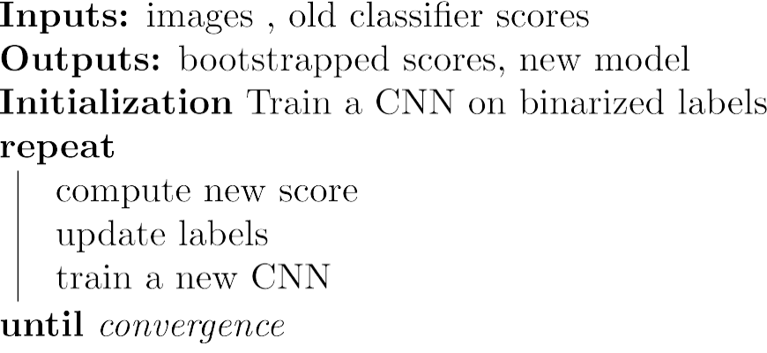
Bootstrapping
To ensure some « continuity », we set the new score as a weighted average of the previous scores.
Notes:
Maha
Relégender

Slide 13
Bootstrapping
Bootstrap 1:
Average of the
last two scores.
Bootstrap 2:
Average on all
previous scores.
Notes:
Maha

Slide 14
Bootstrapping
We observe strong fluctuations in the probabilities, yet the performances are better.
Notes:
Maha
Enlever les .5 -> attention, fragile, j’ai mis des petits carrés blancs partout :p

Slide 15
Bootstrapping extension
Instead of starting from the old classifier labels, use a CNN trained on Tr3 (clean) to initially re-label the training set, then perform bootstrap with averaged scores.
The starting point is much better than in the previous experiment, and the relative improvement is similar for low false positive rate.
Notes:
Simon
It 0 ? nope

Slide 16
Predicting the errors
We train a 4-classes classifier to decide whether or not the binarized label from the old classifier is correct.
(Classes) | True 0 | True 1
Predicted 0 | 0 | 1
Predicted 1 | 2 | 3
We then relabel the samples according to the predicted class and train a new CNN.
Annex
Notes:
Maha
2 réseaux
Renommer, enlever un des 2

Slide 17
Conclusion
The best solution performance-wise remains to use a hand-labelled small subset. Classical performance enhancement methods work : bootstrapping has shown to be very efficient on both clean and noisy datasets.
The models that are taking into account (either in the classifier or via another CNN) the dependence between the noise and the content of the pictures in more refined ways are still limited to simple cases, but are the most promising. Litterature on this topic still focuses on simplified cases, as the whole problem is much more complex.
The performances of our models have been validated on other bases with a similar format.
Notes:
Simon
Point 4: méthodes simplifiés, bruit dépendant, pas aussi simple que ça.

Slide 18
Questions
Thank you!

Slide 19
Notes:
This slide intentionnaly left blank

Slide 20
Appendices - Sizes
back
Notes:
TODO

Slide 21
Appendices – Unbalanced
back
Notes:
TODO

Slide 22
Appendices - Threshold
back

Slide 23
Appendices - Margins
back

Slide 24
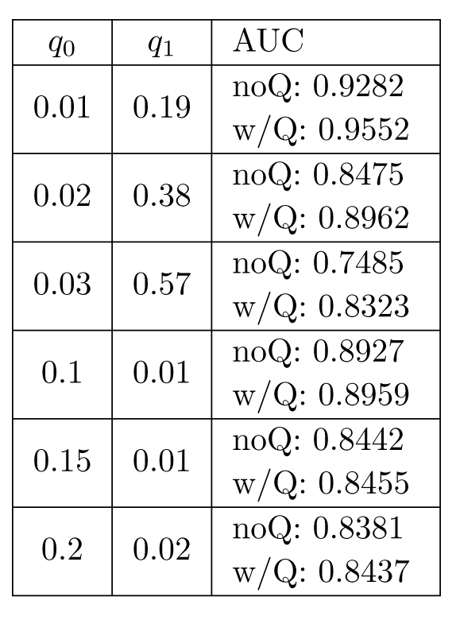
Appendices – Q matrix

Slide 25
Appendices – Simple bootstrap

Slide 26
Appendices – Weighted bootstrap
Bootstrap 1 – 2-moving average
Notes:
TODO

Slide 27
Appendices – Weighted bootstrap
Notes:
TODO

Slide 28
Appendices – Bootstrap extension
Notes:
TODO

Slide 29
Appendices – Other test sets
Notes:
TODO

Slide 30
Appendices – RGB vs Grayscale
Notes:
TODO

Slide 31
Appendices – noise prediction
Confusion matrix
back
Notes:
TODO

